Slide 1

Expectations and Experiences of Short-Term Study Abroad Leadership Teams
Homero Murzi, Kirsten Davis, Desen Ozkan, James Davis, David Knight, & Matt James
October 2020

Slide 2

Background
Global engineering competency is required by engineers (Johri & Jesiek, 2014)
Well-implemented short-term programs have been shown to increase students’ global competency (Chieffo & Griffiths, 2009; Tarrant, Rubin, and Stoner 2013).
Less research on the study abroad leaders experience
The purpose of our study is to unpack engineering study abroad program leaders’ (i.e., faculty members and graduate student leaders) perceptions of their roles throughout a two-week study abroad program

Slide 3

Rising Sophomore Abroad Program Overview
ENGE 1644: Global STEM Practice
Travel Abroad (2 – weeks)
Wednesday Lecture
(All students)
Friday recitation
Individual tracks
Figures source: www.flaticon.com

Slide 4
Methods
Data stream 1:
Program Leaders’ Journals
Data stream 2:
Interviews with Program Leaders
Coding and Themes Analysis
Figures source: www.flaticon.com

Slide 5
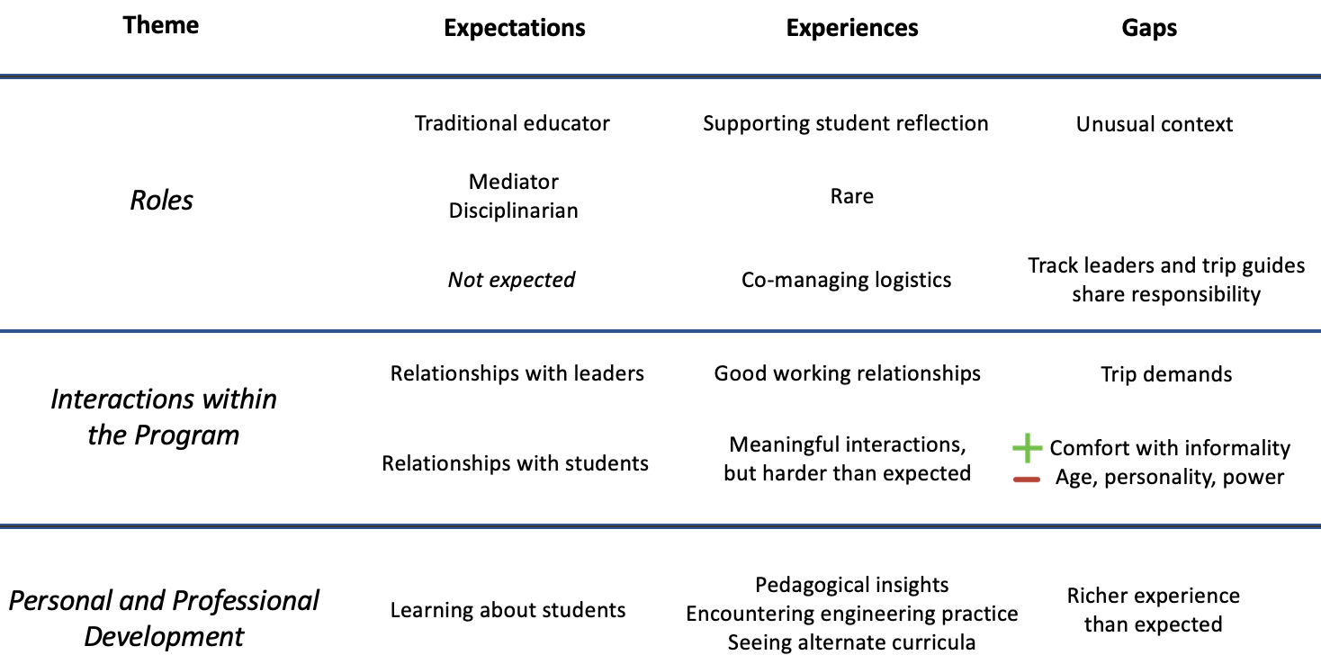
Overview of findings
Expectations and Experiences from each of the emerging themes

Slide 6

Expectations vs. Experiences
“I saw one of the roles as mediator between the students and the faculty and staff, because I thought I'm closer in age, and I work with them most closely in the course. And so I thought I knew them a little bit more and would be able to mediate any issues that might arise like alcohol or whatever, and nip those before they escalated.”
Manage logistics
Support reflection
Challenges in leadership
Emergencies
Image source: www.pixabay.com

Slide 7
Implications
Practice: Guide for study abroad leaders
Education, communication and logistics, health and safety (before and during trip)
Research: Importance of multi-method data collection approach at multiple time points
Figures source: www.flaticon.com

Slide 8
Expectations and Experiences of Short-Term Study Abroad Leadership Teams
Homero Murzi, Kirsten Davis, Desen Ozkan, James Davis, David Knight, & Matt James
hmurzi@vt.edu | @hmurzi | @eclipslab
October 2020

